Slide 1

Minimum Spanning Tree

Slide 2
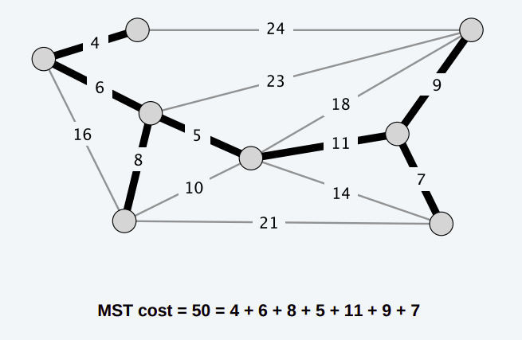
MST (chapter 23)
Two classic algorithms
Kruskal’s
Requires Data Structure for Disjoint Sets
Prim’s
Requires Priority Queue (Heap)

Slide 3
Applications of MST
Design of networks, including computer networks, telecommunications networks, transportation networks, water supply networks, and electrical grids
Approximating the traveling salesman problem
Approximating the multi-terminal minimum cut problem
Approximating the minimum-cost weighted perfect matching
Taxonomy
Cluster analysis
Etc.

Slide 4
Data Structure for Disjoint Sets
Operations
MAKE-SET(x) creates a new set whose only member.
x is not already be in some other set.
UNION(x, y) unites the dynamic sets that contain x and y, say Sx and Sy, into a new set. The representative of the resulting set is any member.
FIND-SET(x) returns the representative of the (unique) set containing x.
Thus, representative is x.
A set is identified by the representative (a member)

Slide 5
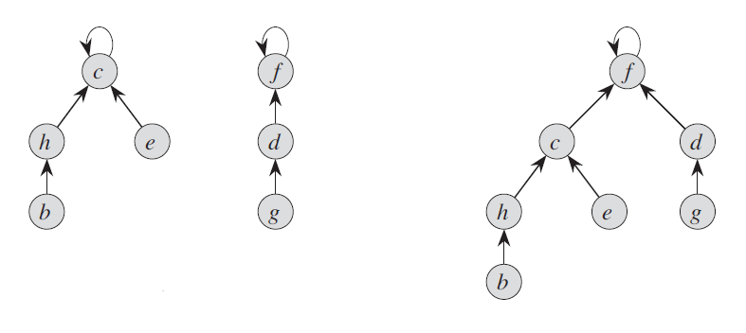
Disjoint-Set Forests (sec 21.3, page 568)
FIND-SET(b) is c
FIND-SET(g) is f
“rank” maintains the approximation of subtree height
is not updated by path compression
UNION

Slide 6
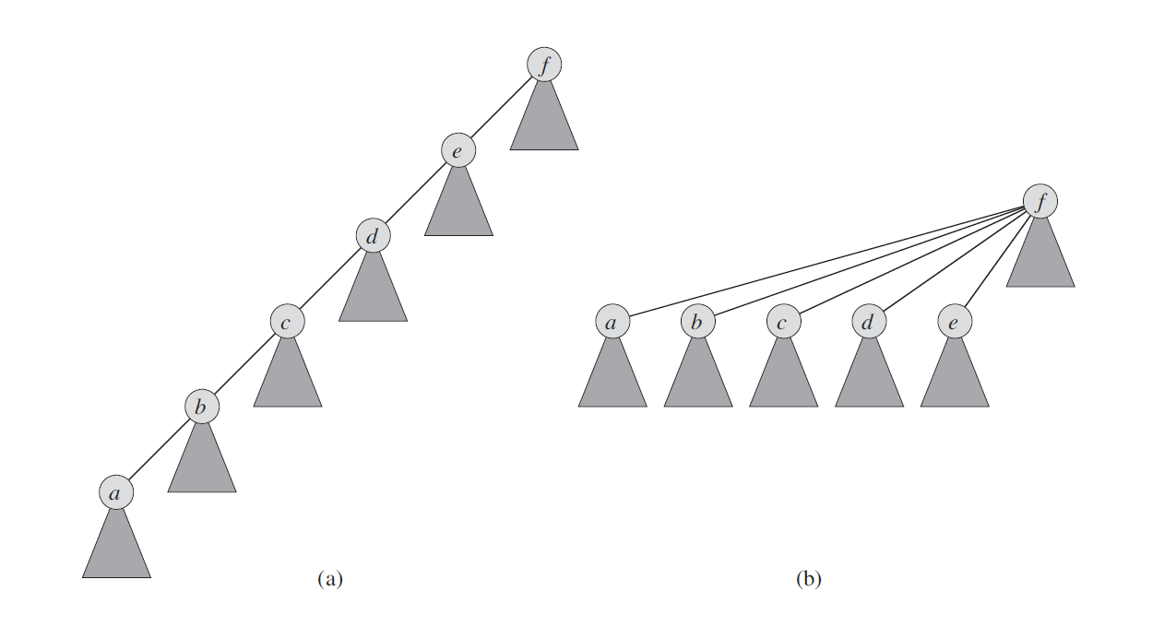
Union by Rank and Path Compression
When Union, make the root with smaller rank become child of the root with larger rank
When Find-set, update every parent on the find-path to be root

Slide 7
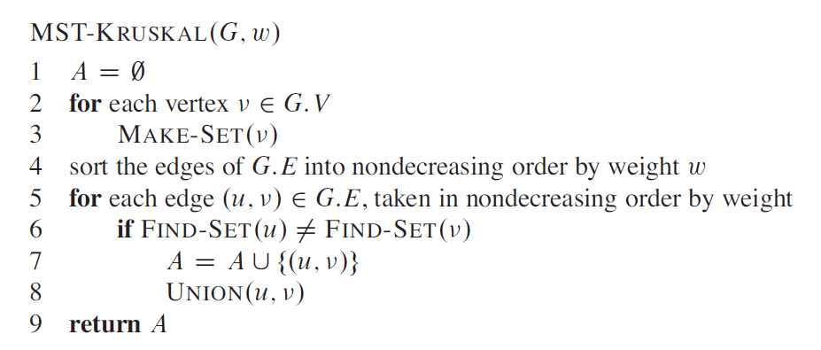
Kruskal’s MST
A tree may not contain cycle.
Disjoint sets are utilized for cycle detection

Slide 8
Kruskal’s MST

Slide 9
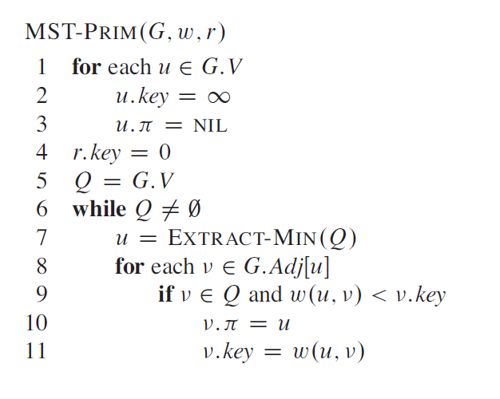
Prim’s MST
Priority Queue is utilized for vertex selection as the priority (value of key) of each vertex changes dynamically

Slide 10
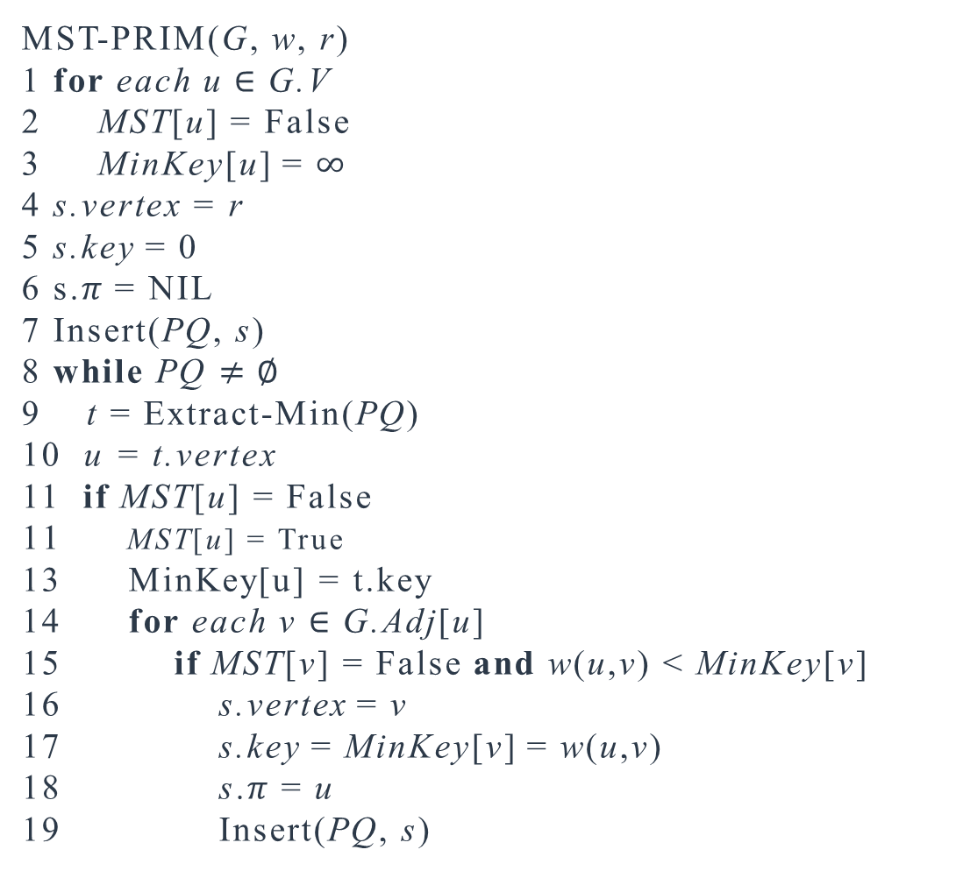
Prim’s MST with simple heap
MST-PRIM(G, w, r)
1 for each u $∈$G.V
2 MST[u] = False
3 MinKey[u] = $∞$
4 s.vertex = r
5 s.key = 0
6 s.$π$ = NIL
7 Insert(PQ, s)
8 while PQ $≠∅$
9 t = Extract-Min(PQ)
10 u = t.vertex
11 if MST[u] = False
MST[u] = True
13 MinKey[u] = t.key
14 for each v $∈$G.Adj[u]
15 if MST[v] = False and w(u,v) < MinKey[v]
16 s.vertex = v
17 s.key = MinKey[v] = w(u,v)
18 s.$π$ = u
19 Insert(PQ, s)
Simple heap does not support changing value of node’s key.
A vertex may be inserted multiple times with different values of key.
Once a vertex is extracted, subsequent copy will be ignored.

Slide 11
Prim’s MST

